Slide 1


Apr 2023
E-scooter Demand Prediction in Austin
SDS 384 Final Project Presentation
Team 1
Ziyu Fan, Zizhe Jiang, Jeil Oh
The University of Texas at Austin

Slide 2
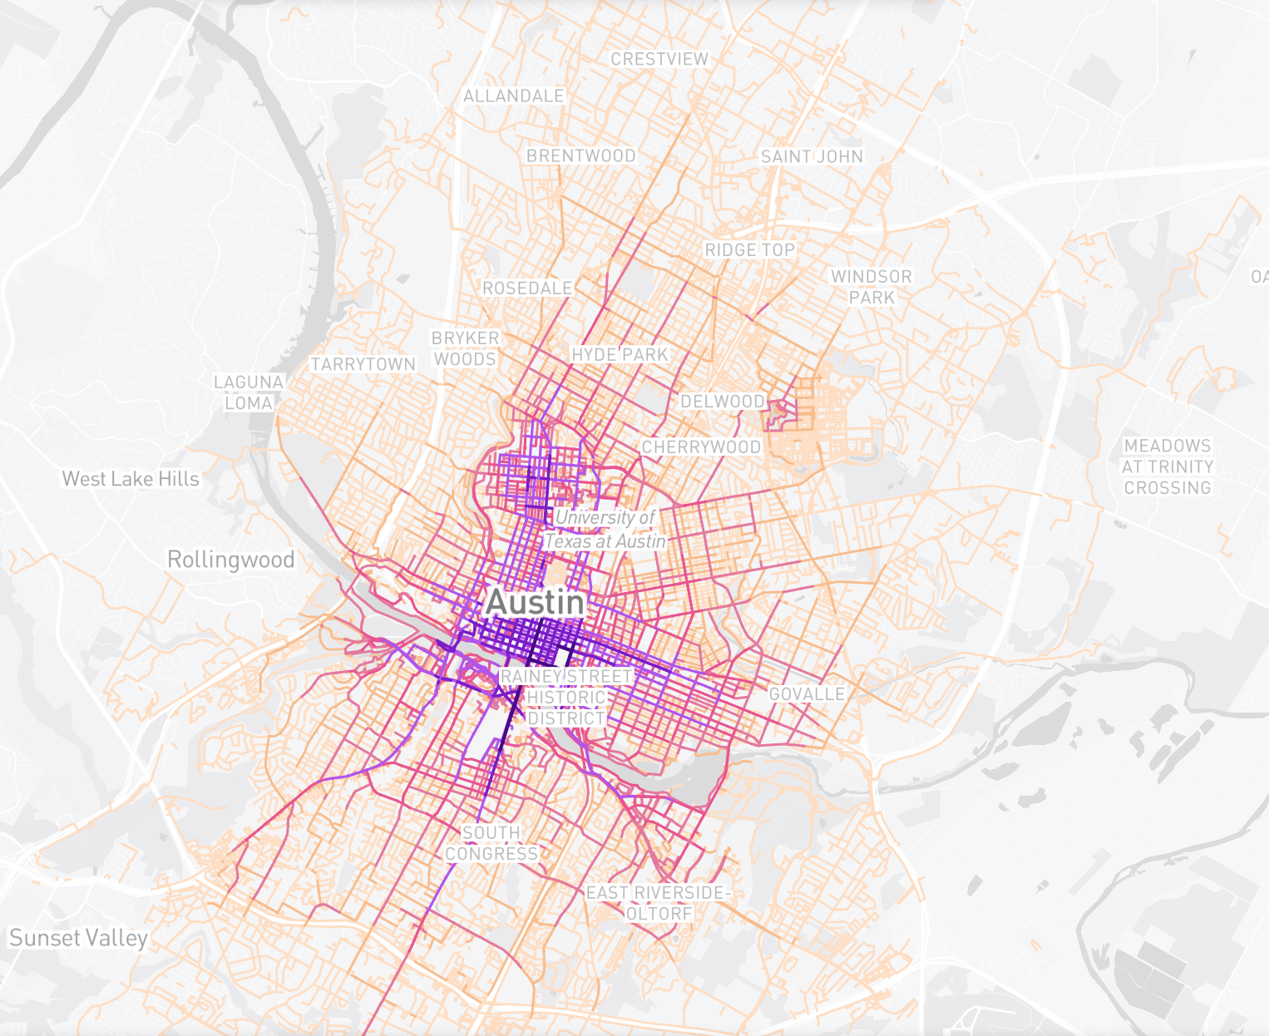
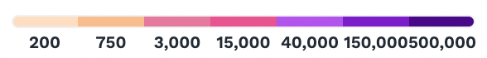
Motivation
The electric scooter has become a common sight in every major US city.
Operating companies must maximize their scooter or e-bike usage by positioning their fleets according to demand to stay competitive.
To better understand the demand, we employed various machine learning techniques to analyze the data provided by the city of Austin, TX.
Our goal was to identify key factors that have a significant impact on the demand.

Slide 3
Dataset
Data Source
Shared Micromobility Vehicle Trips
which contains shared micromobility vehicle trip data reported to the City of Austin Transportation Department as part of the Shared Small Vehicle Mobility Systems operating rules.
Data size
5,425,258 trips in 2019

Slide 4
Dataset
Data cleaning
2019 only
Removed:
Trip duration > 12 hours, or
Trip distance > 50 miles
Outcome
Number of trips
Predictors
Month
Hour
Day of Week
Census Tract Start/End

Slide 5
Demographic - 2017 US Census Tract
Population
Gender
Race
Citizenship
Median household income
Poverty rate
Occupation
Commute mode
Mean commute time
Employment status

Slide 6
Demographic - 2017 US Census Tract
Population
Gender
Race
Citizenship
Median household income
Poverty rate
Occupation
Commute mode
Mean commute time
Employment status
Census Tract Starts | 269
Census Tract Ends | 248
Unique Census Tracts in the data | 275
Notes:
The differences between these 3 values indicates that there are census tracts that have only trip starts or only trip ends.

Slide 7
Exploratory data analysis

Slide 8
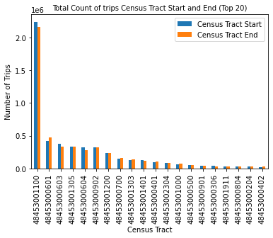
Exploratory data analysis
Which census tracts have the most traffic?
Notes:
Downtown, UT, upper west campus, Bouldin Creek

Slide 9
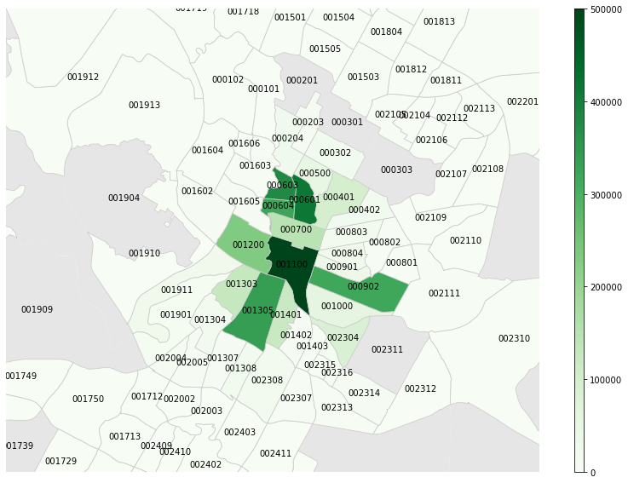
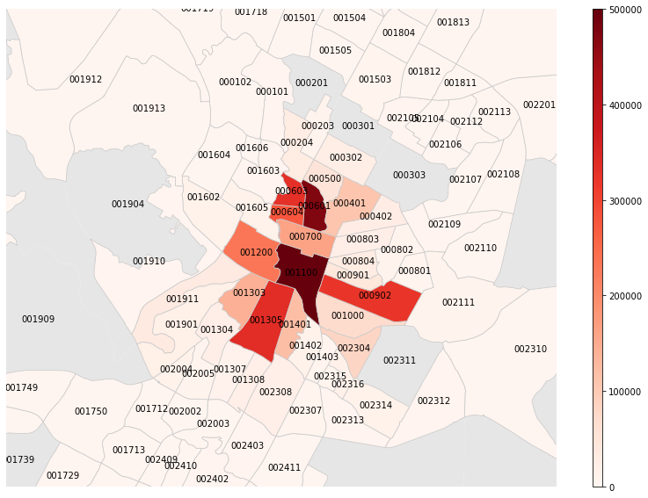
Exploratory data analysis
Choropleth maps of census tract starts/ends
Notes:
Downtown, UT, upper west campus, Bouldin Creek

Slide 10
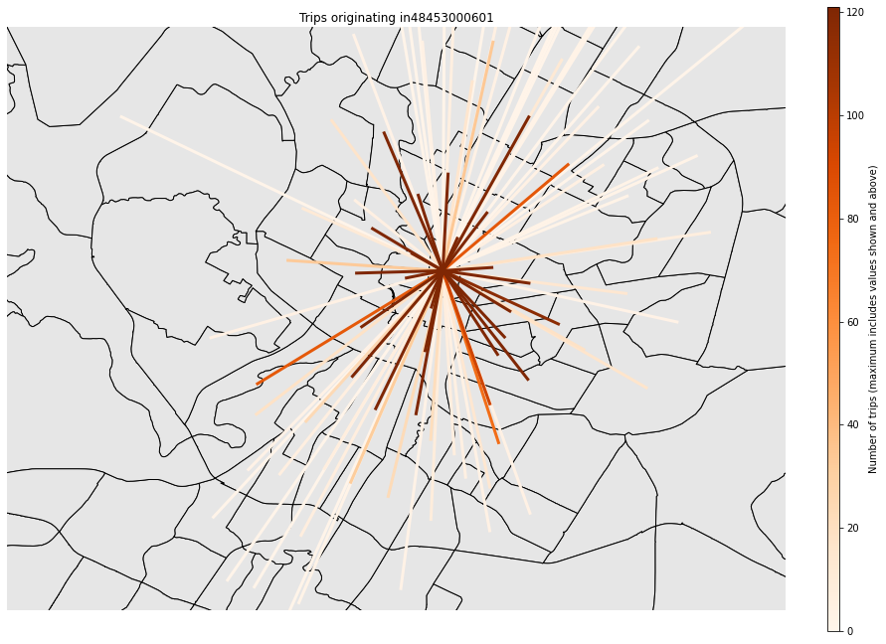
Exploratory data analysis
What does movement between Census Tracts look like?

Slide 11
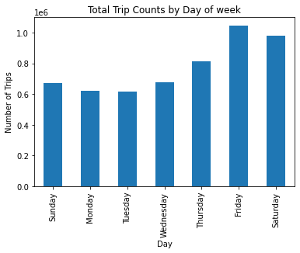
Exploratory data analysis
Which days have the most traffic?

Slide 12
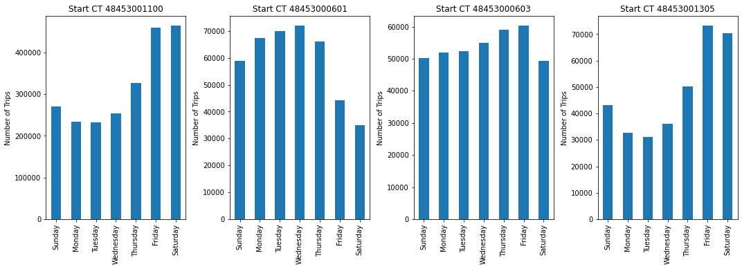
Exploratory data analysis
Does location affect day of week traffic differently?
Notes:
Downtown, UT, upper west campus, Bouldin Creek

Slide 13
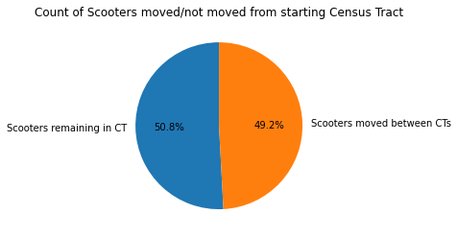
Exploratory data analysis
How many trips start and end in different Census Tracts?

Slide 14
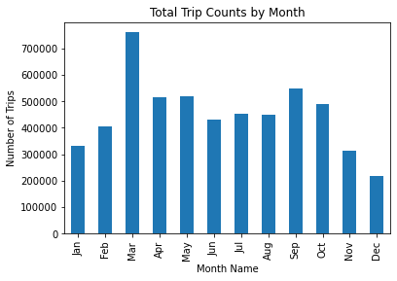
Exploratory data analysis
Are certain months more popular than others?

Slide 15
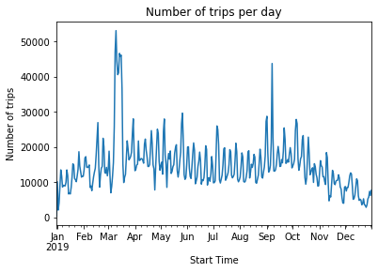
Exploratory data analysis
How has ridership changed over time?
Notes:
In mid-march of 2019, there is a peak that coincides with Austin's SXSW conference. The regularly spaced spikes in the data appear to fall on weekends.

Slide 16
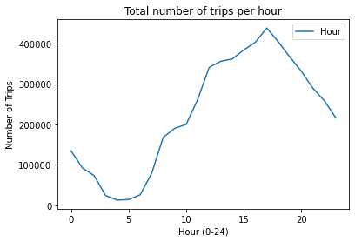
Exploratory data analysis
How does time of day affect ridership?

Slide 17
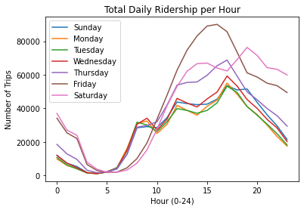
Exploratory data analysis
How does time of day affect ridership?

Slide 18
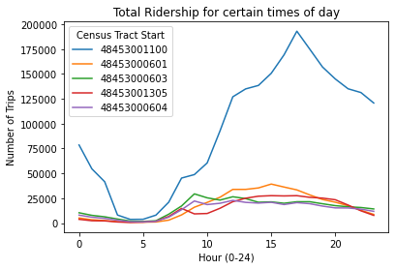
Exploratory data analysis
How does time of day affect ridership?

Slide 19
ML Regression models to predict E-scooter demand

Slide 20
Linear Model
Objective: To predict the number of trips using a linear regression model
Input features: County_ID, Day of Week, Hour,
Information from TrackID: Men/Women, Race and Income
Output feature: num_trips
Method:
Linear Regression
Ridge Regression

Slide 21
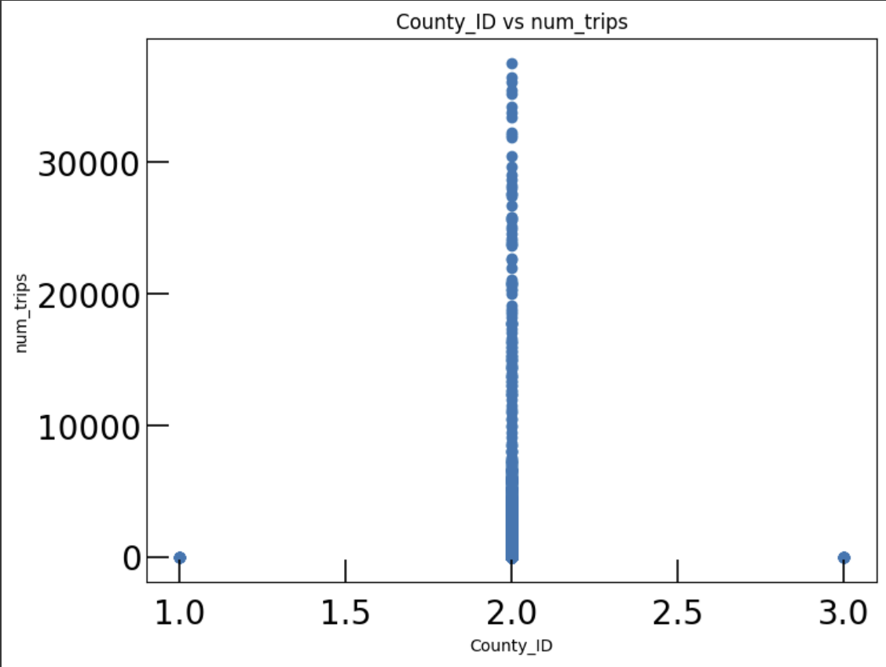
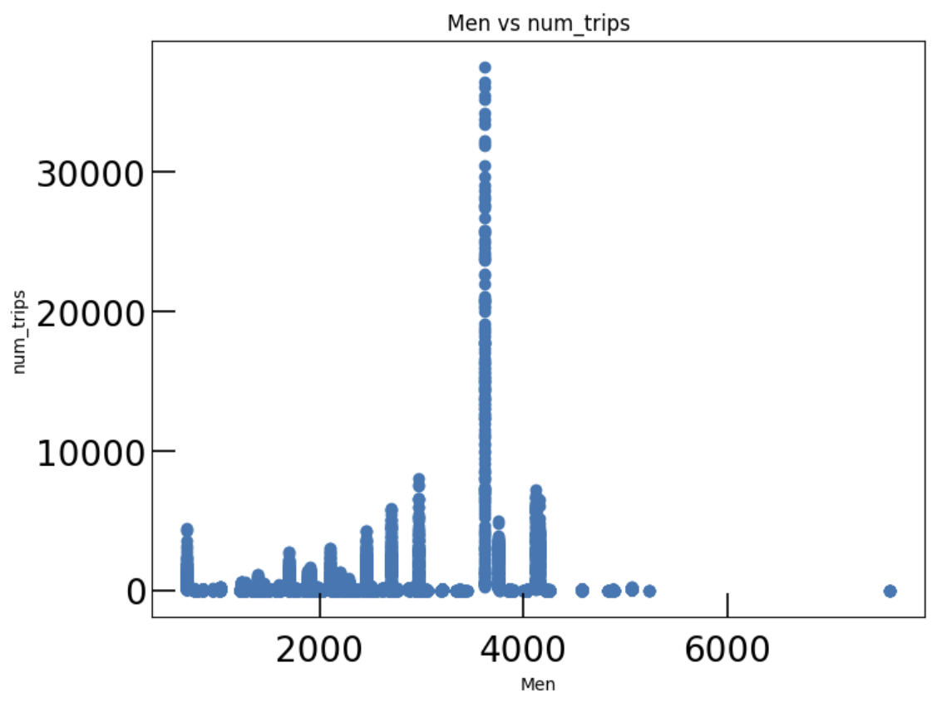
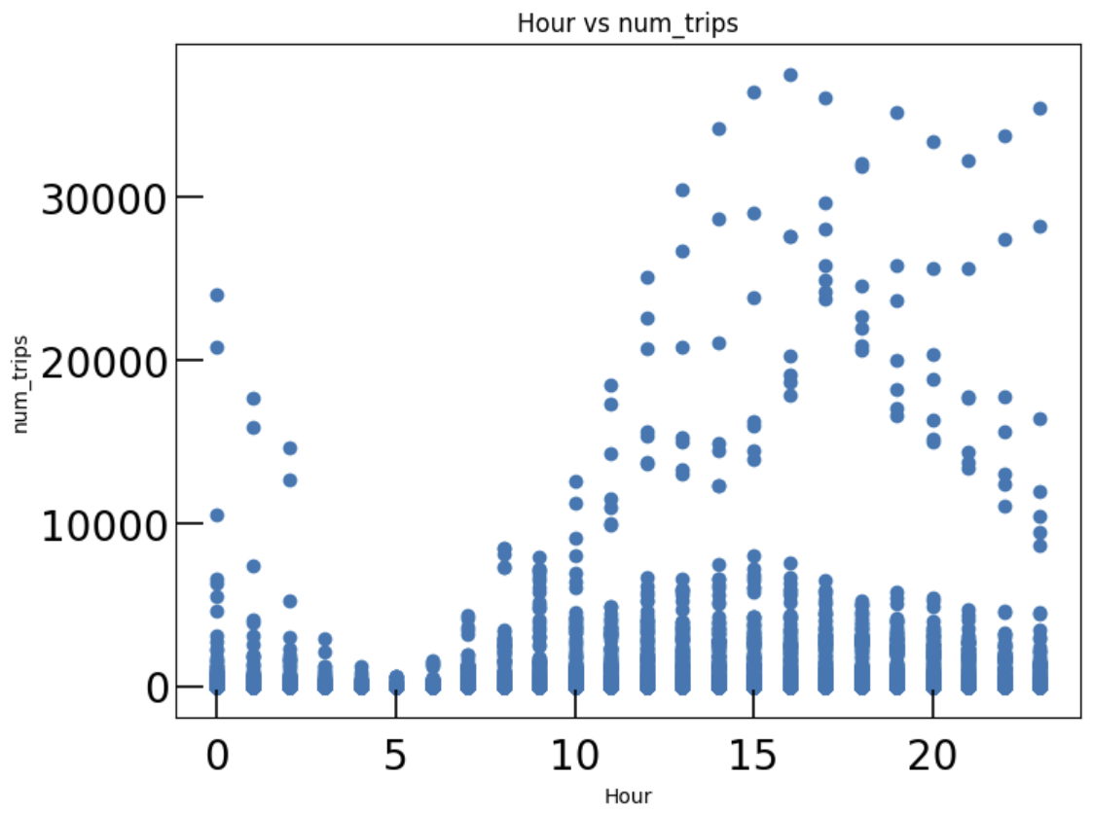
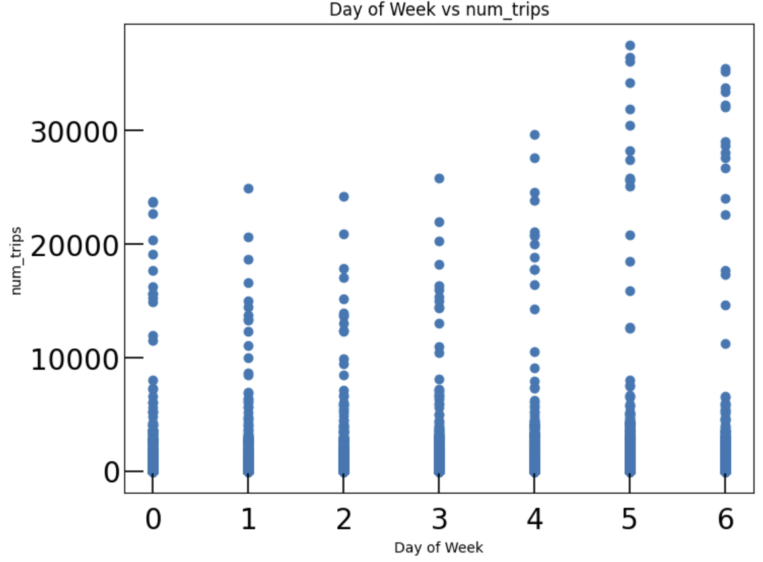

Slide 22
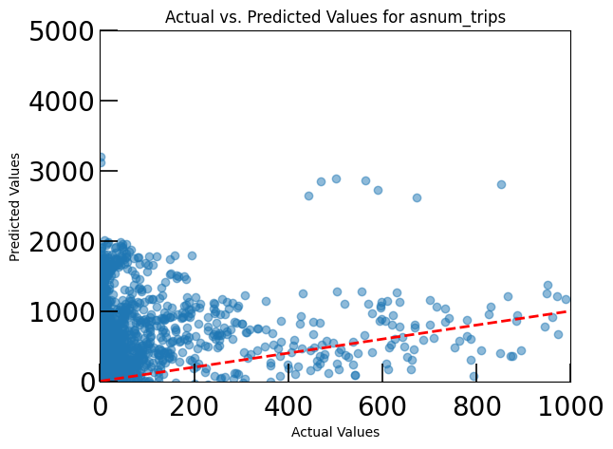
Linear Regression
Mean Squared Error: 3131517.819943295

Slide 23
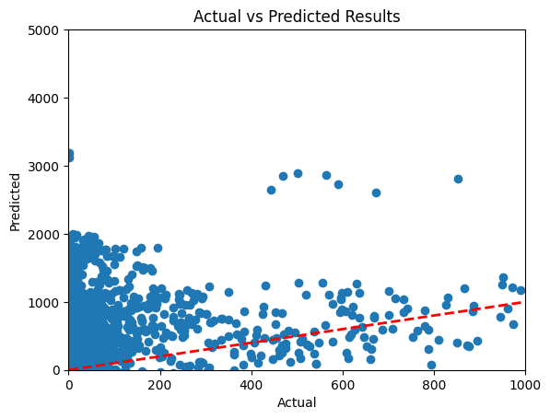
Ridge Regression

Slide 24
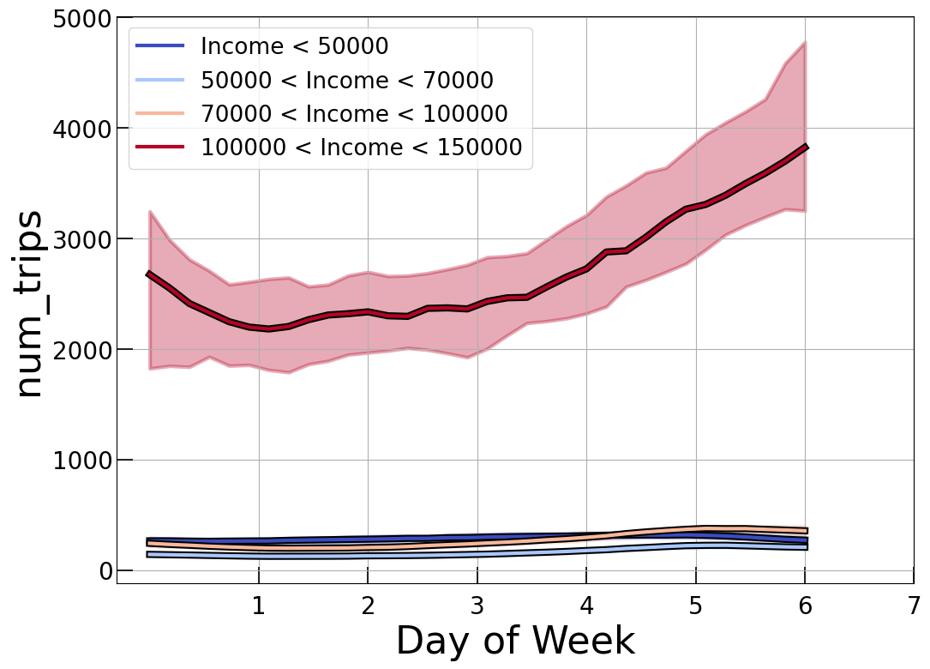
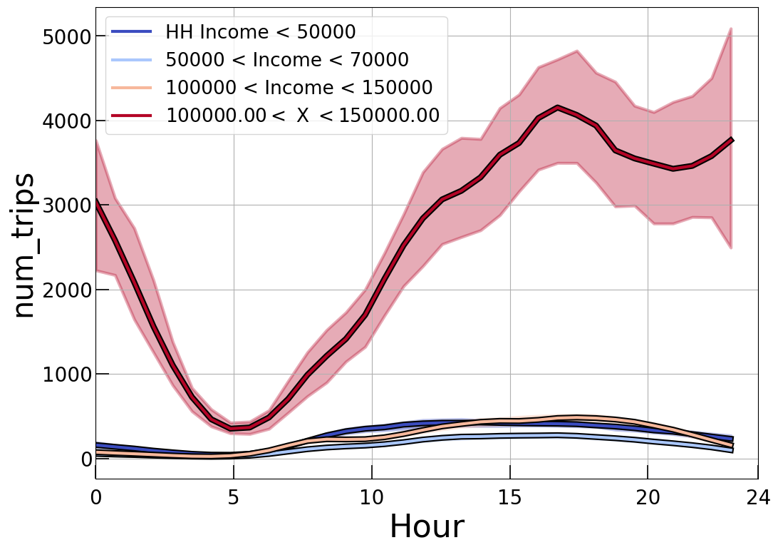
KLLR Group by income

Slide 25
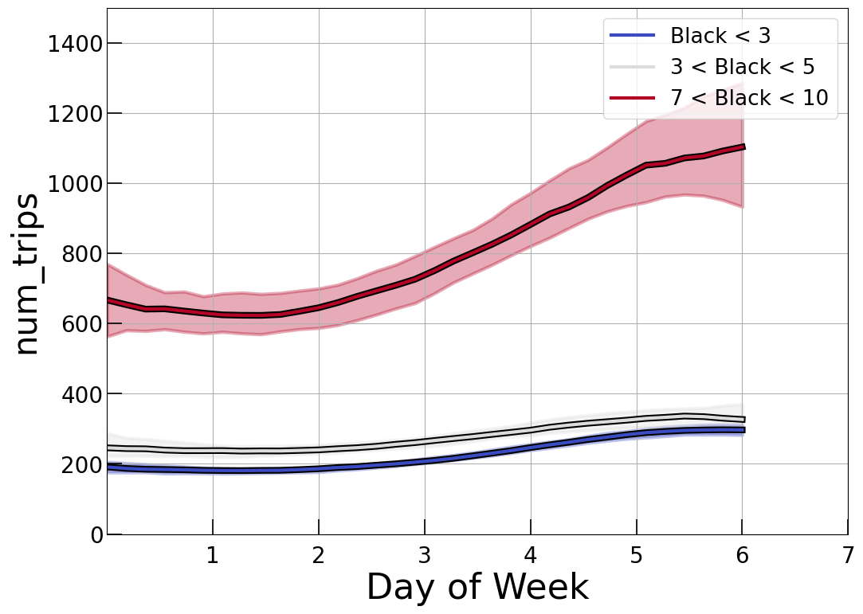
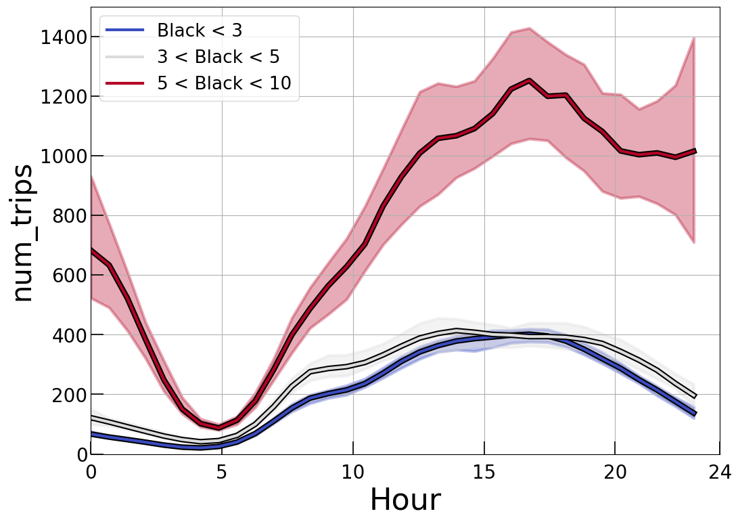
KLLR Group by Race

Slide 26
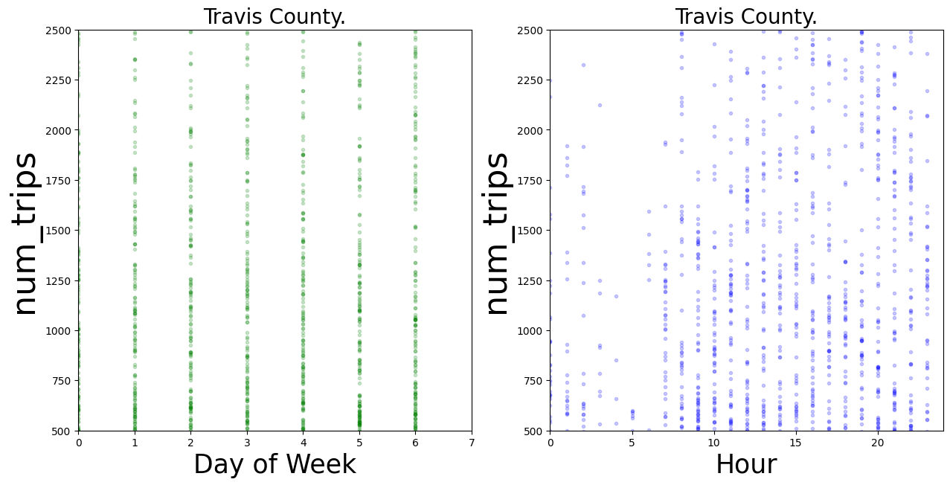
Visualizing the raw data

Slide 27
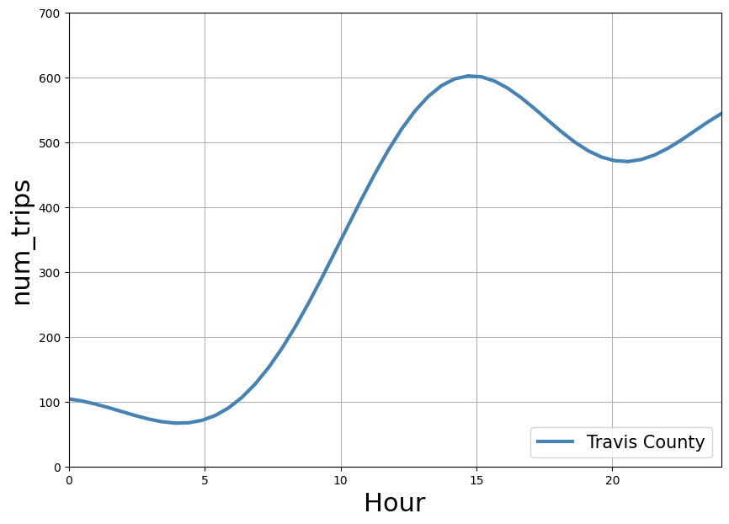
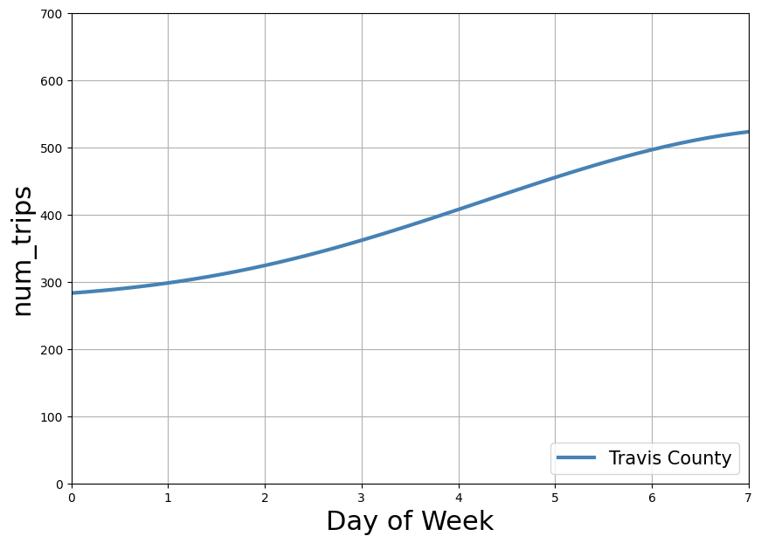
Gaussian Process Regression

Slide 28
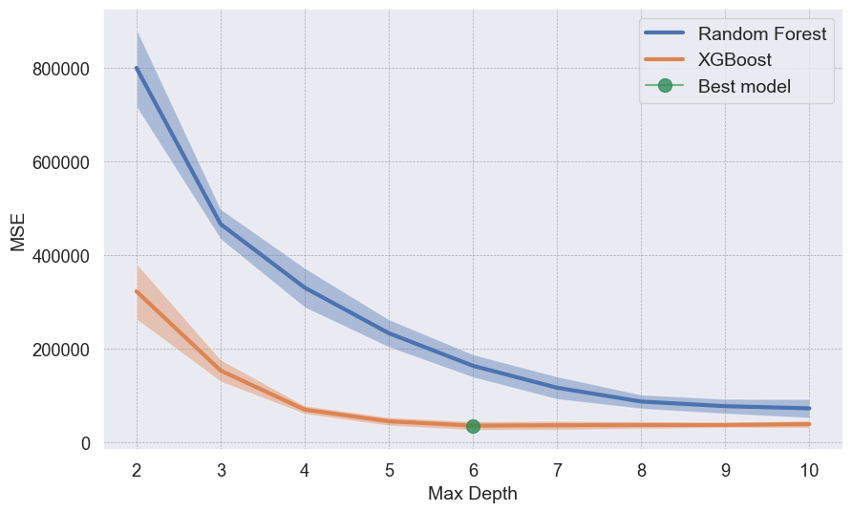
Regression: Random Forest and XGBoost
5-fold Cross validation
Train
85%
Data
Test
15%

Slide 29
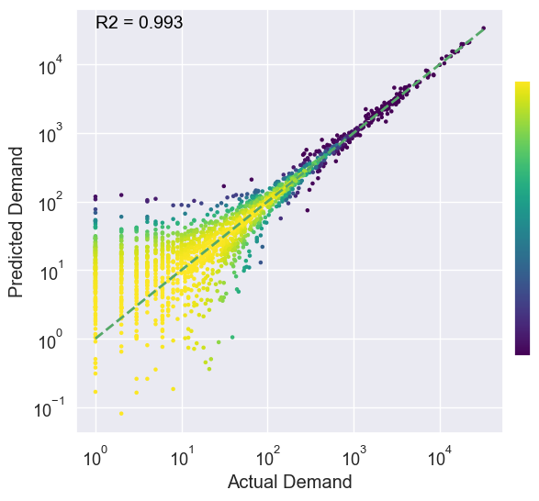
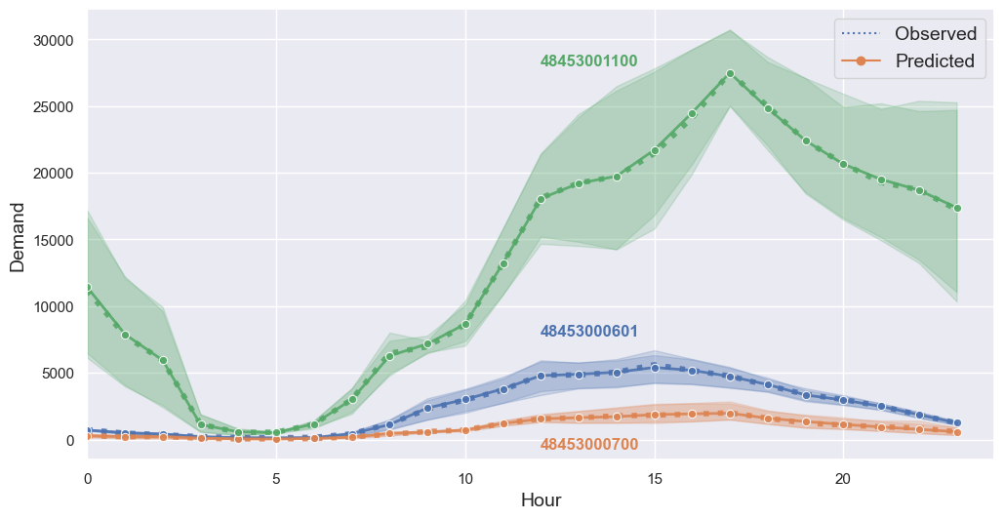
Regression: Random Forest and XGBoost
E-scooter hourly demand prediction

Slide 30
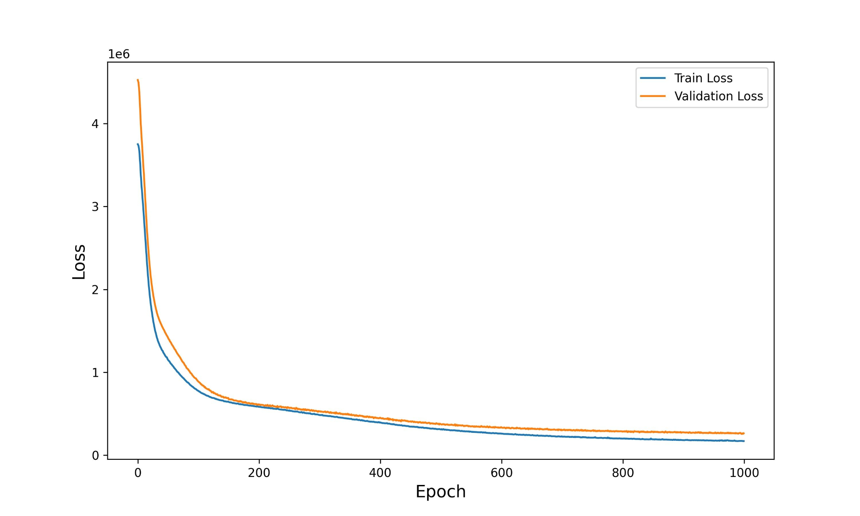
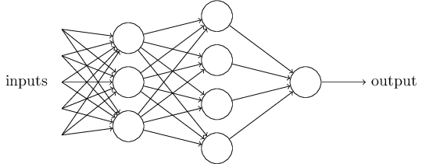
Regression: Neural Network
Two fully connected hidden layers, each containing 100 neurons and utilizing the ReLU activation function
Adam optimizer to minimize the mean squared error loss

Slide 31
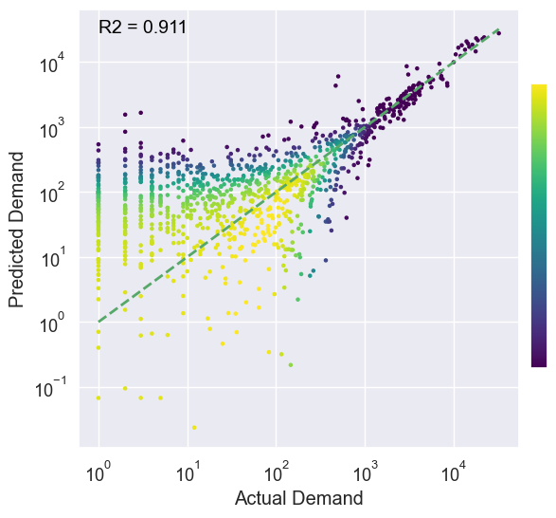
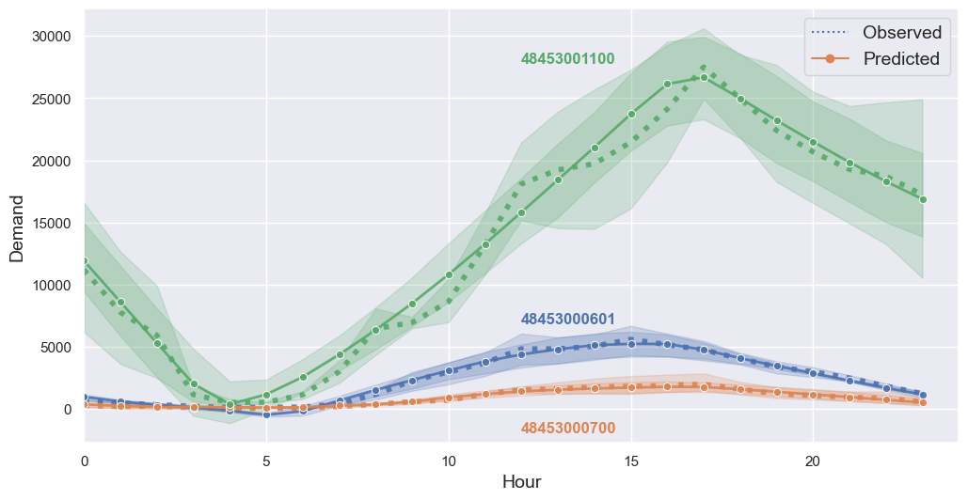
Regression: Neural Network
E-scooter hourly demand prediction

Slide 32
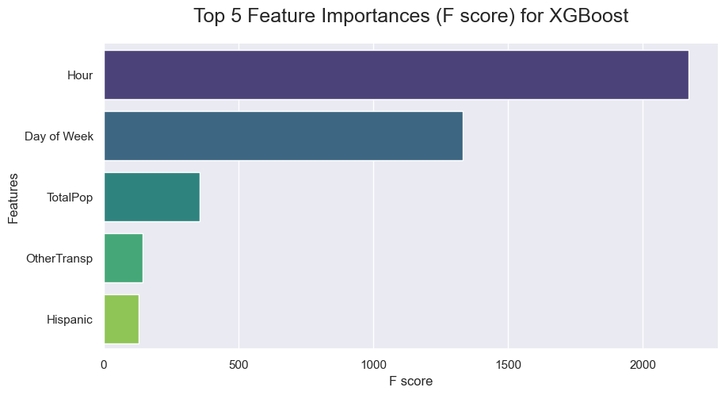
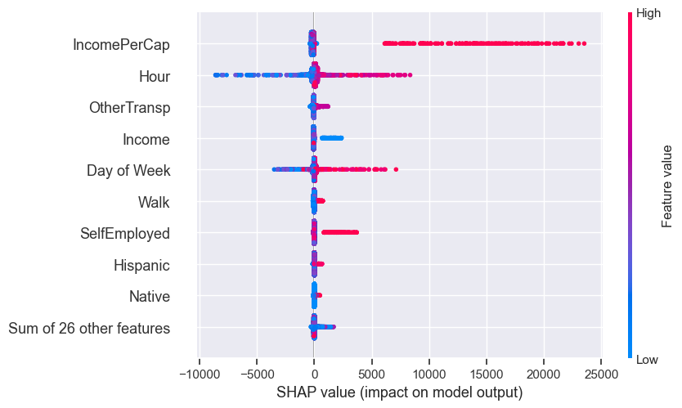
Interpretation
Time does matter: Hour, Day of Week

Slide 33
Interpretation
Time does matter: Hour, Day of Week
Demand for E-scooters based on race?

Slide 34
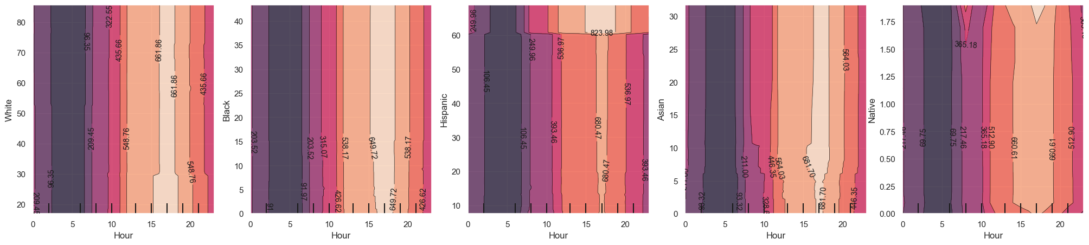
Interpretation
White
Black
Hispanic
Asian
Native
For most racial groups, changes in racial composition do not result in significant shifts in demand.
Area with more than 60% Hispanic population shows higher E-scooter demand.

Slide 35
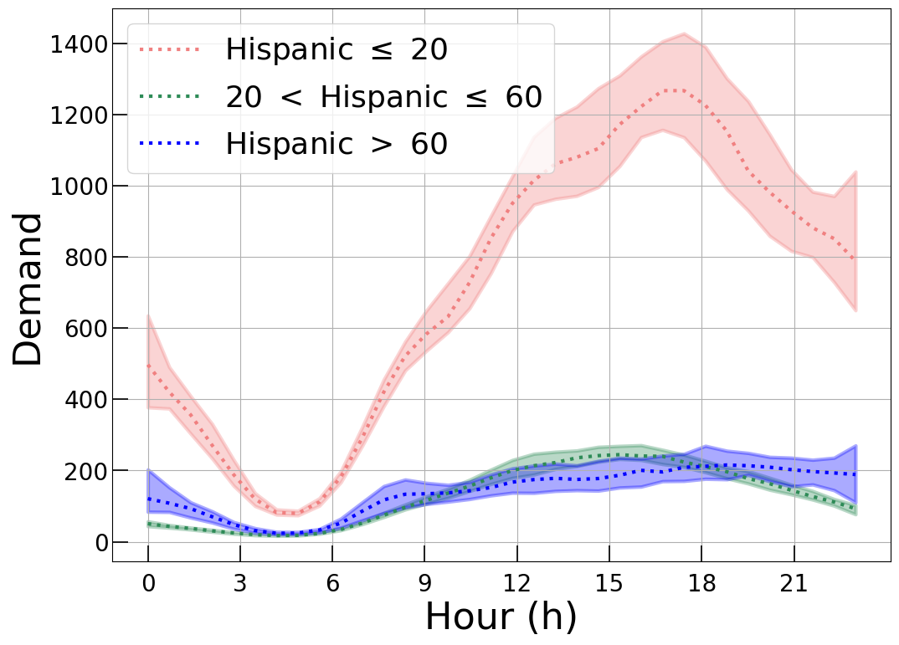
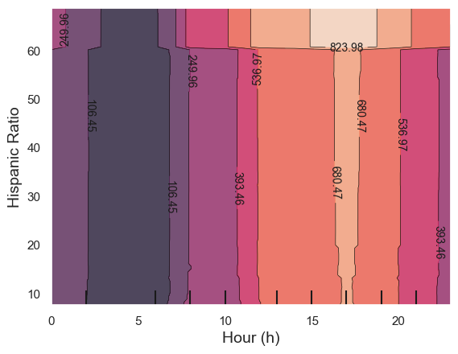
Interpretation
Areas with over 60% Hispanic population may be underrepresented in e-scooter distribution, despite the high potential demand.
PDP assumes that the features of interest are not correlated with other features.

Slide 36
Conclusion
Best model: XGBoost
High-resolution demand prediction can assist e-scooter service providers in optimizing device placement and inform public transportation policymakers.
Future research is needed to address potential equity issues and ensure fair distribution and accessibility of transportation resources for all.

Slide 37
Thank you！

